Slide 1



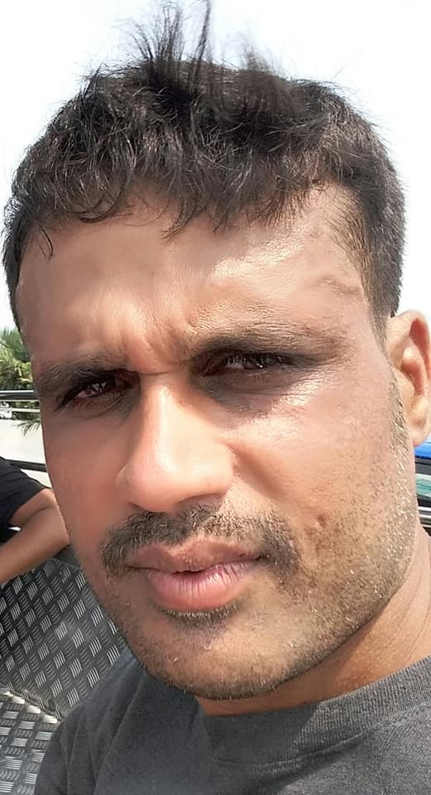






RIVERVALE ROCKETS CRICKET CLUB RIVERVALE ROCKETS CRICKET CLUB RIVERVALE ROCKETS CRICKET CLUB RIVERVALE ROCKETS CRICKET CLUB RIVERVALE ROCKETS CRICKET CLUB RIVERVALE ROCKETS CRICKET CLUB RIVERVALE ROCKETS CRICKET CLUB RIVERVALE ROCKETS CRICKET CLUB
SCORE
CUP
OVERS
8
4
BALLS
MAIDEN
17
1
FOUR’S
RUNS
0
4
SIXES’S
Rocket Singh of the Match
WICKETS
0
RAVI BHARATHI
4
Mustangs vs Mighty Tigers
9-Aug-2023
RIVERVALE ROCKETS CRICKET CLUB RIVERVALE ROCKETS CRICKET CLUB RIVERVALE ROCKETS CRICKET CLUB RIVERVALE ROCKETS CRICKET CLUB RIVERVALE ROCKETS CRICKET CLUB RIVERVALE ROCKETS CRICKET CLUB RIVERVALE ROCKETS CRICKET CLUB RIVERVALE ROCKETS CRICKET CLUB

